Slide 1
BIIT Attendance system
Supervised By:
Mr. Zahid
Presented by:
Ahsan Ismail
2016-arid-2132

Slide 2
Objectives:
An application to reduce paper work.
The system will allow teacher to send a notification to the student whose attendance is below the passing criteria.
Teacher will be able to view attendance of any class at any time.
Student’s attendance percentage will be updated immediately after teacher will submit attendance.
The system will allow the Director to edit attendance of a particular student.

Slide 3






Conceptual Diagram:
Web Sever
See Records
Add students, Add teachers , Maintain records
Request
Admin
Response
Response
Request
Response
Take attendance , send notification
BIIT Attendance System
View and edit attendance
Response
Response
View attendance
Teacher
Response
DB
Student
Director

Slide 4
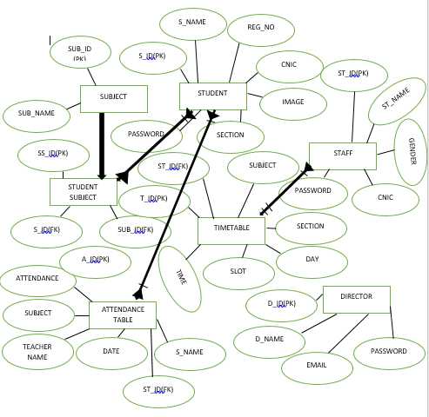
ERD:

Slide 5
DFD(Data Flow Diagram) Level 0
Request
BIIT Attendance Management System
Director
Response
Request
Request
Response
Response
Student
Response
Request
Teacher
Admin

Slide 6
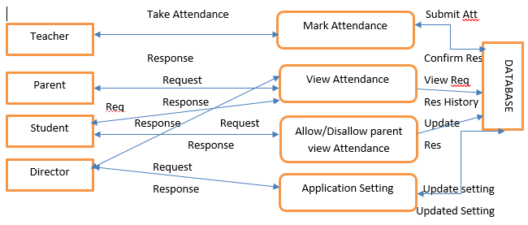
Level 1

Slide 7
Tools and Technologies:
Android Studio.
Visual Studio.
Sql Server .
Web Service.

Slide 8
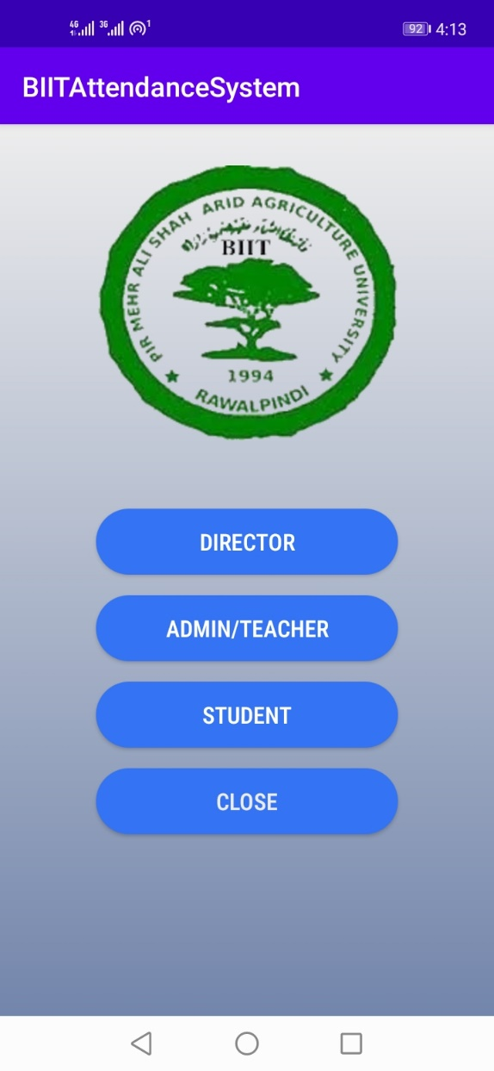
Screen Shots: (Dashboard)

Slide 9
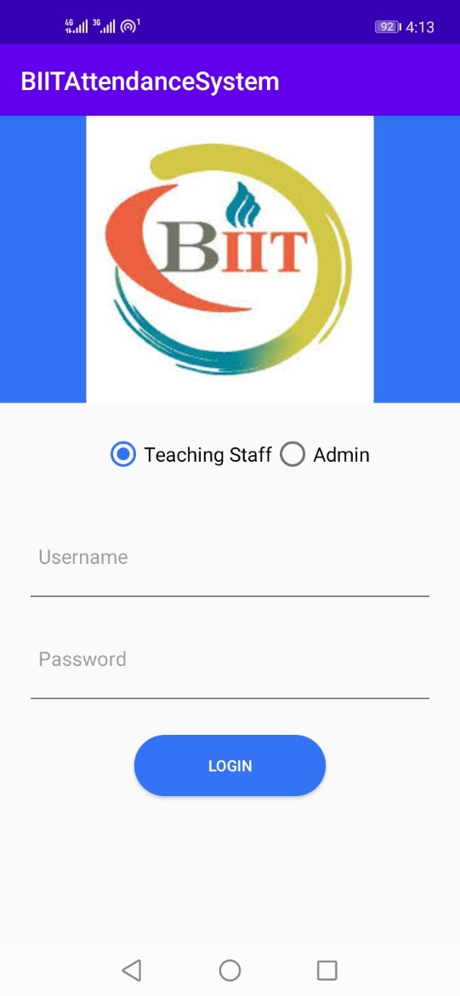
(Login page)

Slide 10
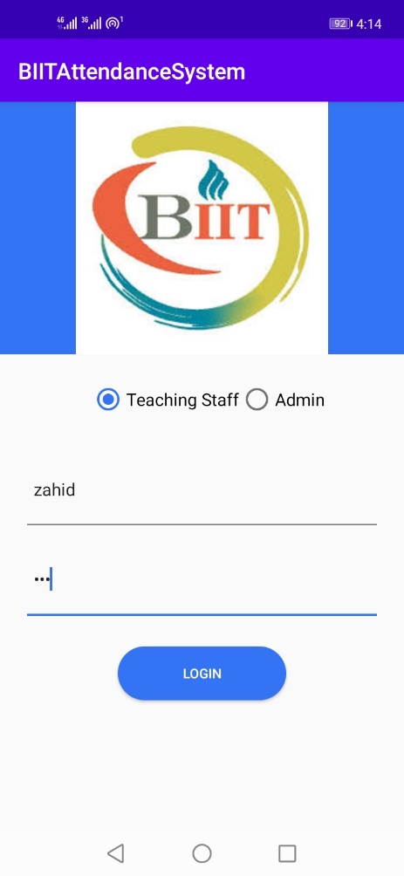
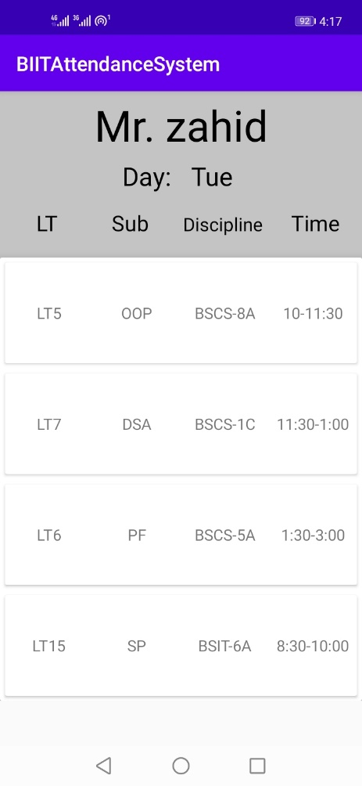
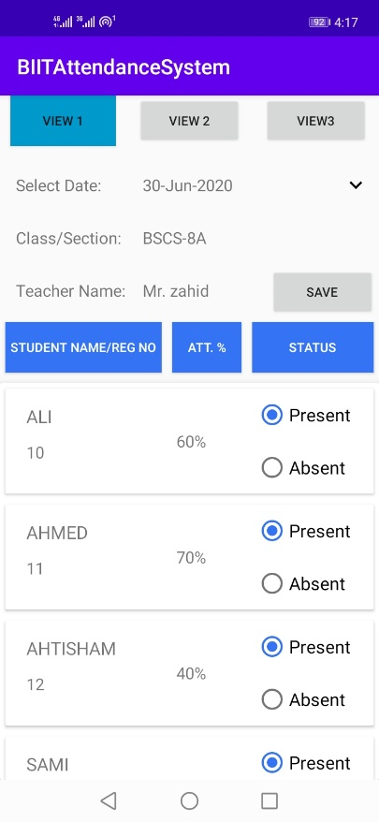
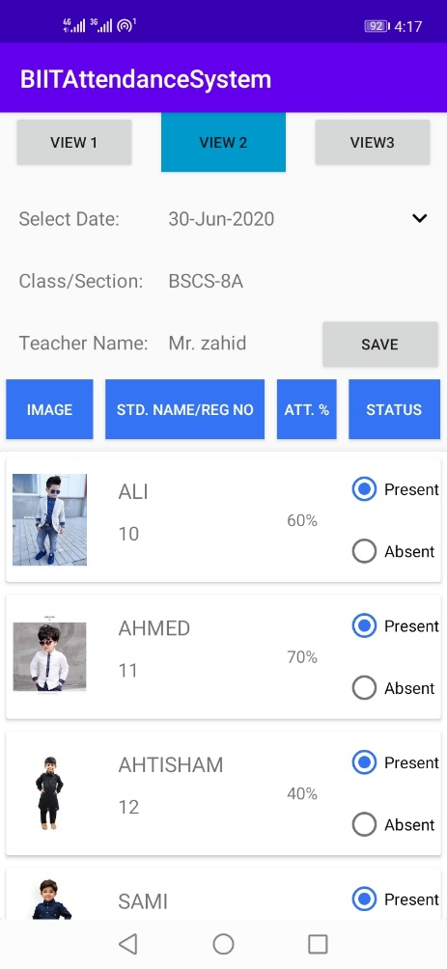
(Teacher side)

Slide 11
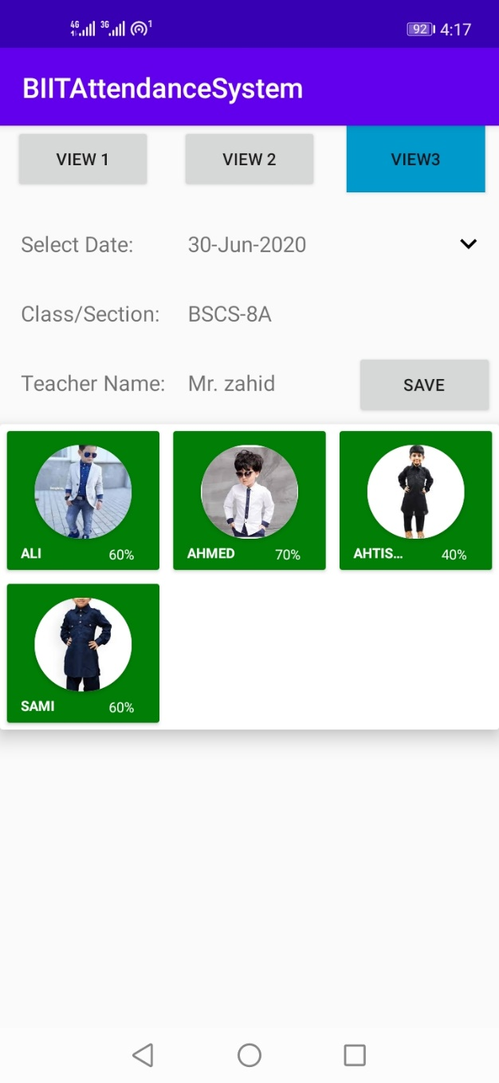
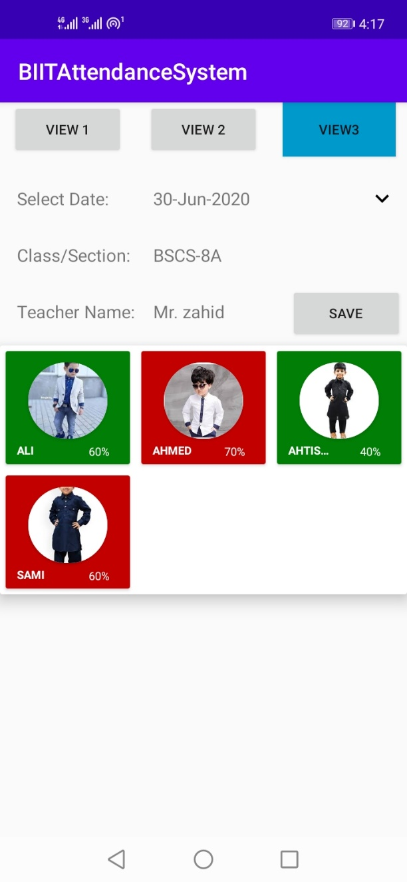


Slide 12

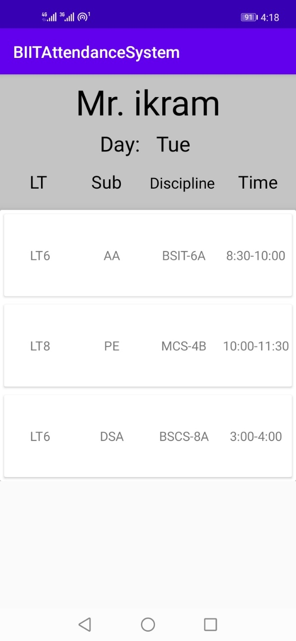
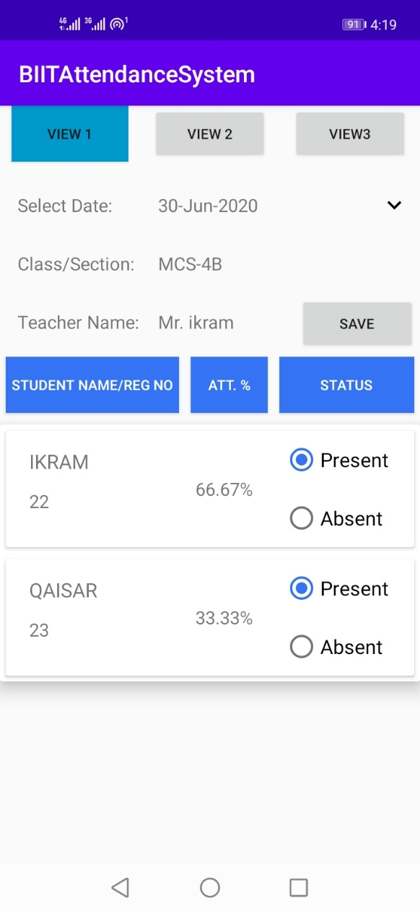

Slide 13
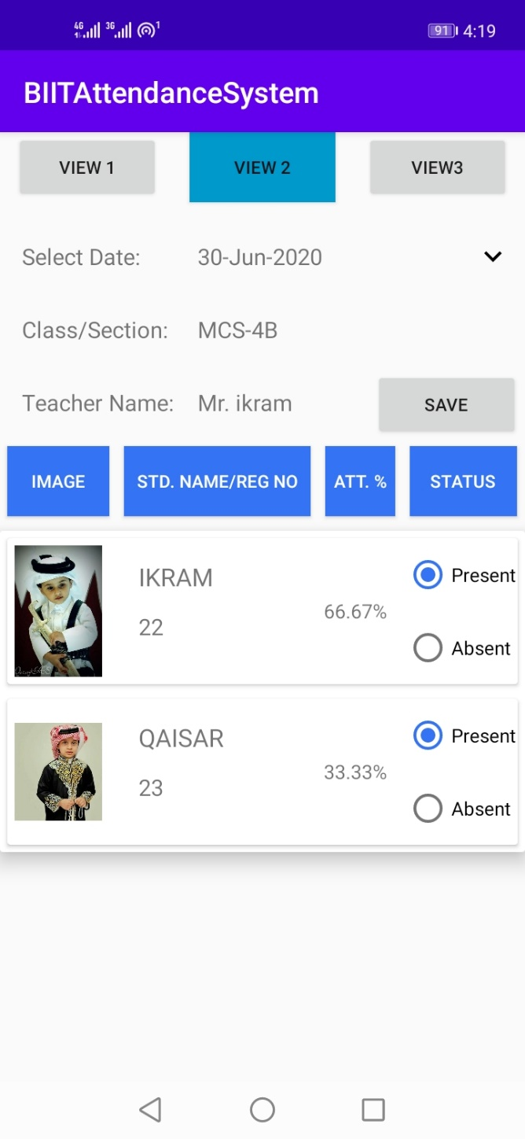
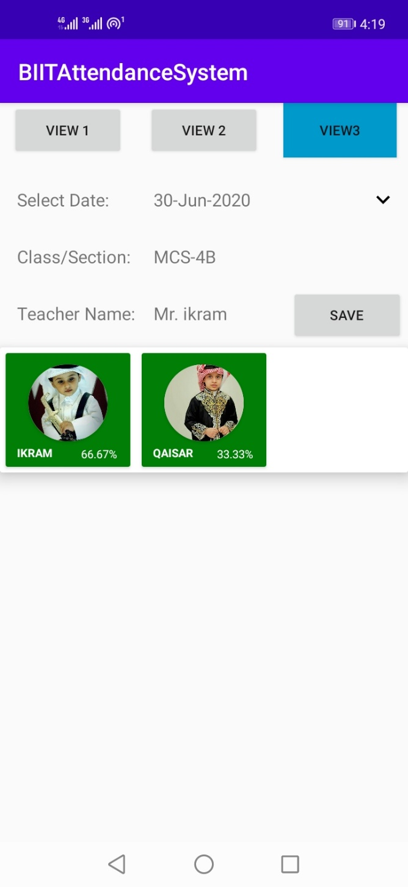

Slide 14

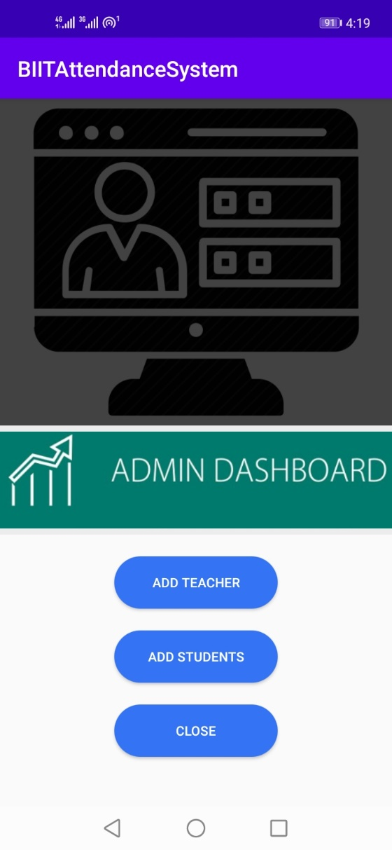
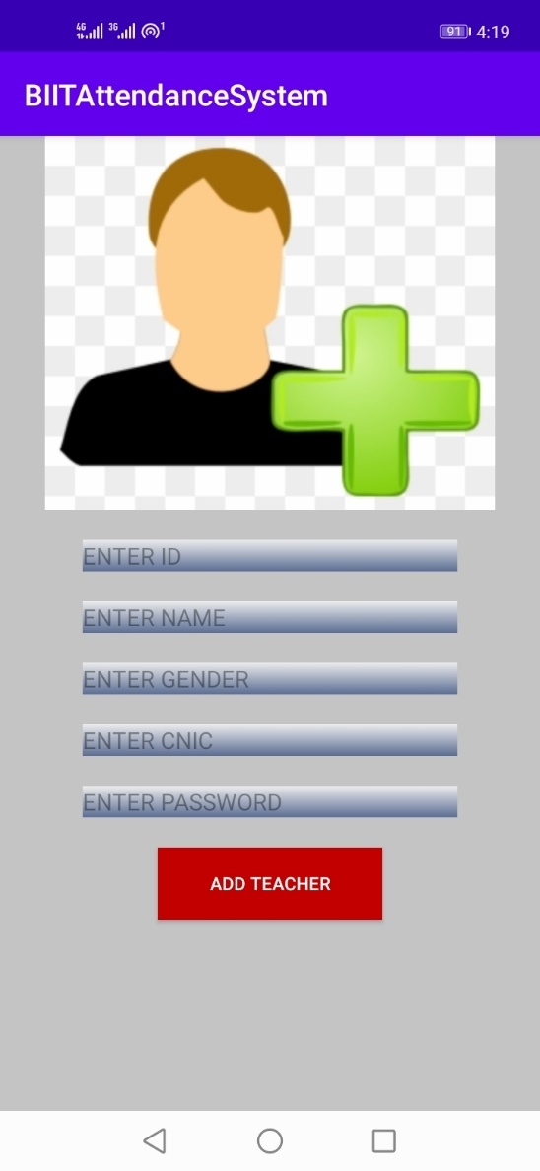
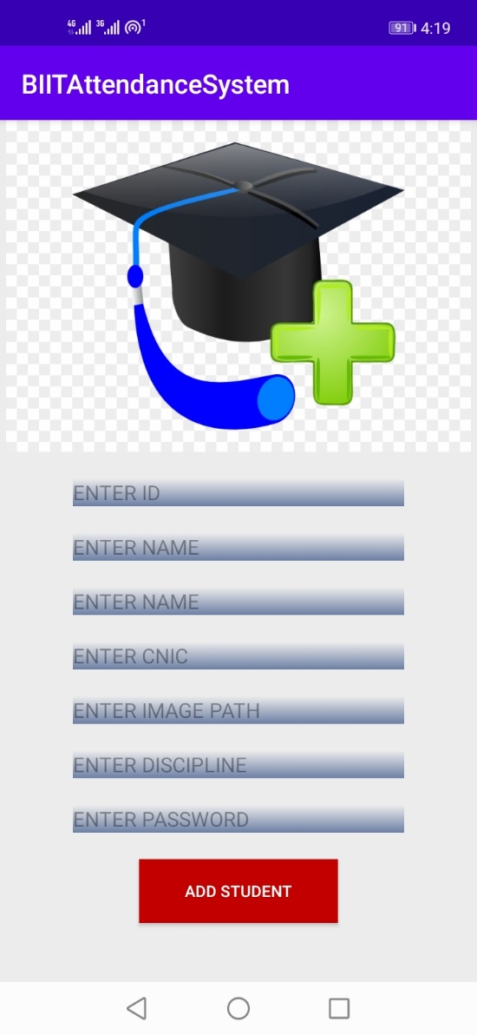
Admin Side:

Slide 15
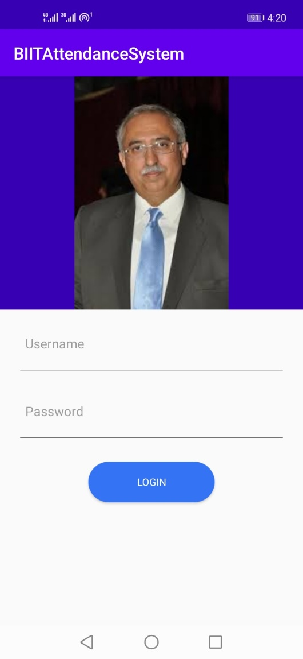

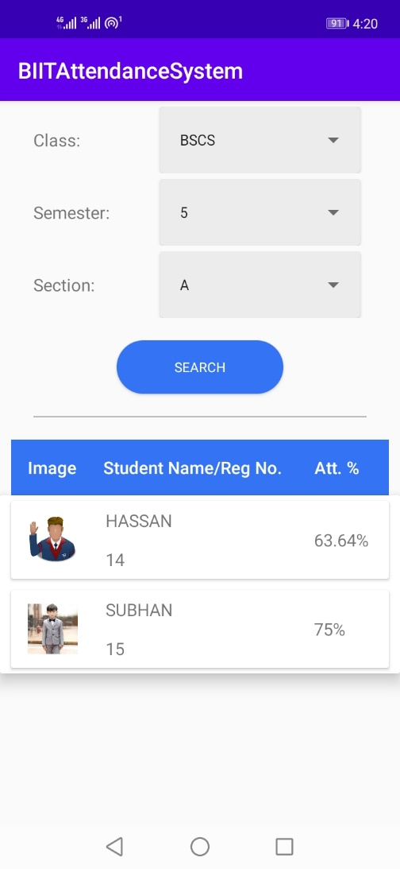
(Director Side)

Slide 16
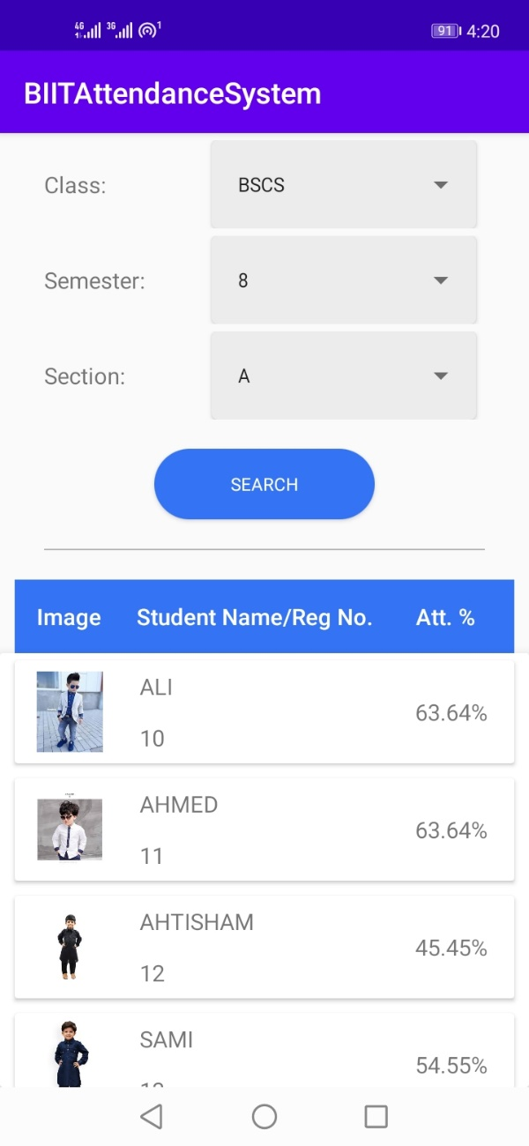
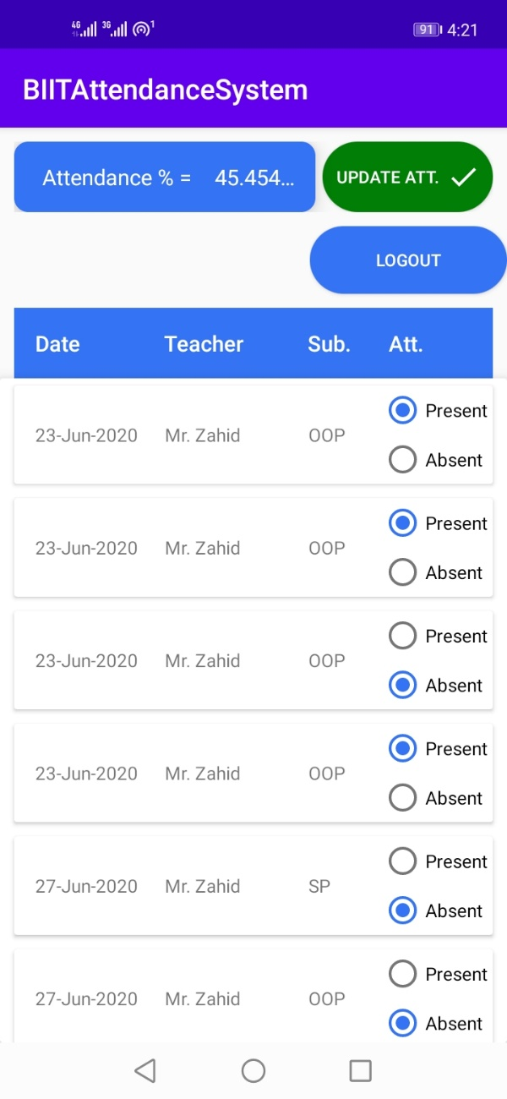
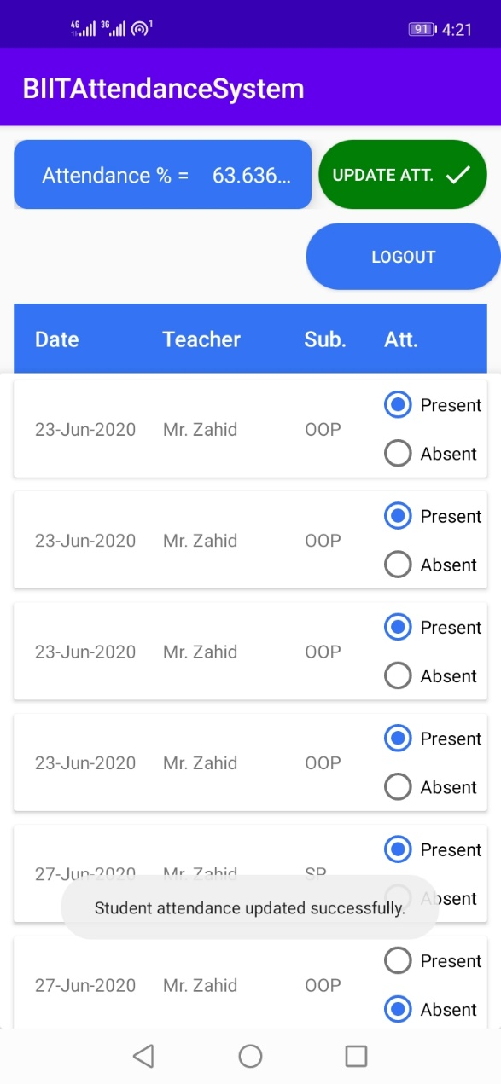

Slide 17
END

